Slide 1
Manikanta

Slide 2
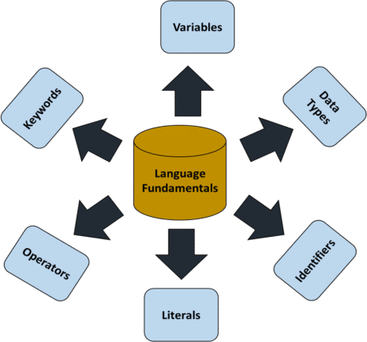
Java
The previous topic cleared the compiler and interpreter doubt but still, there are questions such as “How to store different numbers in java?” or “What value you can store in java and how?”, etc.
To clear all such doubts we have prepared this “Language Fundamentals” topic which includes the basic concepts to write programs in Java.

Slide 3
Java
Java Identifiers
In Java, identifiers are used for identification purposes. Java Identifiers can be a class name, method name, variable name, or label.
public class Test{
public static void main(String[] args) {
int a = 20;
}
}
In the above Java code, we have 5 identifiers namely :
Test: class name.
main: method name.
String: predefined class name.
args: variable name.
a: variable name.

Slide 4
Java
Rules For Defining Java Identifiers
There are certain rules for defining a valid Java identifier. These rules must be followed, otherwise, we get a compile-time error. These rules are also valid for other languages like C, and C++.
The only allowed characters for identifiers are all alphanumeric characters([A-Z],[a-z],[0-9]), ‘$‘(dollar sign) and ‘_‘ (underscore).For example “test@” is not a valid Java identifier as it contains a ‘@’ a special character.
Identifiers should not start with digits([0-9]). For example “123Test” is not a valid Java identifier.
Java identifiers are case-sensitive.
There is no limit on the length of the identifier but it is advisable to use an optimum length of 4 – 15 letters only.
Reserved Words can’t be used as an identifier. For example “int while = 20;” is an invalid statement as a while is a reserved word. There are 53 reserved words in Java.

Slide 5
Java
My Variable // contains a space
123test // Begins with a digit
a+c // plus sign is not an alphanumeric character
variable-2 // hyphen is not an alphanumeric character
sum_&_difference // ampersand is not an alphanumeric character
Reserved Words in Java
Any programming language reserves some words to represent functionalities defined by that language. These words are called reserved words. They can be briefly categorized into two parts: keywords(50) and literals(3). Keywords define functionalities and literals define value. Identifiers are used by symbol tables in various analyzing phases(like lexical, syntax, and semantic) of a compiler architecture.

Slide 6
Java
abstract | continue | for | protected | transient
Assert | Default | Goto | public | Try
Boolean | Do | If | Static | throws
break | double | implements | strictfp | Package
byte | else | import | super | Private
case | enum | Interface | Short | switch
Catch | Extends | instanceof | return | void
Char | Final | Int | synchronized | volatile
class | finally | long | throw | Date
const | float | Native | This | while

Slide 7
Java
Keywords
In Java, Keywords or Reserved words are the words in a language that are used for some internal process or represent some predefined actions. These words are therefore not allowed to use as variable names or objects.
Keywords are the reserved words which are having predefined meaning in Java.
All the keywords are defined in lower case and the meaning of these keywords can’t be modified.
Java Keywords List
Java contains a list of keywords or reserved words which are also highlighted with different colors be it an IDE or editor in order to segregate the differences between flexible words and reserved words. They are listed below in the table with the primary action associated with them.

Slide 8
Java
Keyword | Usage
abstract | Specifies that a class or method will be implemented later, in a subclass
assert | Assert describes a predicate placed in a Java program to indicate that the developer thinks that the predicate is always true at that place.
boolean | A data type that can hold True and False values only
break | A control statement for breaking out of loops.
byte | A data type that can hold 8-bit data values
case | Used in switch statements to mark blocks of text
catch | Catches exceptions generated by try statements
char | A data type that can hold unsigned 16-bit Unicode characters
class | Declares a new class
continue | Sends control back outside a loop
default | Specifies the default block of code in a switch statement

Slide 9
Java
do | Starts a do-while loop
double | A data type that can hold 64-bit floating-point numbers
else | Indicates alternative branches in an if statement
enum | A Java keyword is used to declare an enumerated type. Enumerations extend the base class.
extends | Indicates that a class is derived from another class or interface
final | Indicates that a variable holds a constant value or that a method will not be overridden
finally | Indicates a block of code in a try-catch structure that will always be executed
float | A data type that holds a 32-bit floating-point number

Slide 10
Java
for | Used to start a for loop
if | Tests a true/false expression and branches accordingly
implements | Specifies that a class implements an interface
import | References other classes
instanceof | Indicates whether an object is an instance of a specific class or implements an interface
int | A data type that can hold a 32-bit signed integer
interface | Declares an interface
long | A data type that holds a 64-bit integer
native | Specifies that a method is implemented with native (platform-specific) code
new | Creates new objects
null | This indicates that a reference does not refer to anything

Slide 11
Java
package | Declares a Java package
private | An access specifier indicating that a method or variable may be accessed only in the class it’s declared in
protected | An access specifier indicating that a method or variable may only be accessed in the class it’s declared in (or a subclass of the class it’s declared in or other classes in the same package)
public | An access specifier used for classes, interfaces, methods, and variables indicating that an item is accessible throughout the application (or where the class that defines it is accessible)
return | Sends control and possibly a return value back from a called method
short | A data type that can hold a 16-bit integer
static | Indicates that a variable or method is a class method (rather than being limited to one particular object)
strictfp | A Java keyword is used to restrict the precision and rounding of floating-point calculations to ensure portability.
super | Refers to a class’s base class (used in a method or class constructor)
switch | A statement that executes code based on a test value

Slide 12
Java
synchronized | Specifies critical sections or methods in multithreaded code
this | Refers to the current object in a method or constructor
throw | Creates an exception
throws | Indicates what exceptions may be thrown by a method
transient | Specifies that a variable is not part of an object’s persistent state
try | Starts a block of code that will be tested for exceptions
void | Specifies that a method does not have a return value
volatile | This indicates that a variable may change asynchronously
while | Starts a while loop
sealed | The sealed keyword is used to declare a class as “sealed,” meaning it restricts which classes can extend it.
permits | The permits keyword is used within a sealed class declaration to specify the subclasses that are permitted to extend it.

Slide 13
Java
Important Points on Java Keywords
The keywords const and goto are reserved, even though they are not currently in use.
Currently, they are no longer supported in Java. Reserved for future use

Slide 14
Java
DataTypes :
Java is statically typed and also a strongly typed language because, in Java, each type of data (such as integer, character, hexadecimal, packed decimal, and so forth) is predefined as part of the programming language and all constants or variables defined for a given program must be described with one of the Java data types.
Data Types in Java:
Data types in Java are of different sizes and values that can be stored in the variable that is made as per convenience and circumstances to cover up all test cases. Java has two categories in which data types are segregated
Primitive Data Type: such as boolean, char, int, short, byte, long, float, and double
Non-Primitive Data Type or Object Data type: such as String, Array, etc.

Slide 15
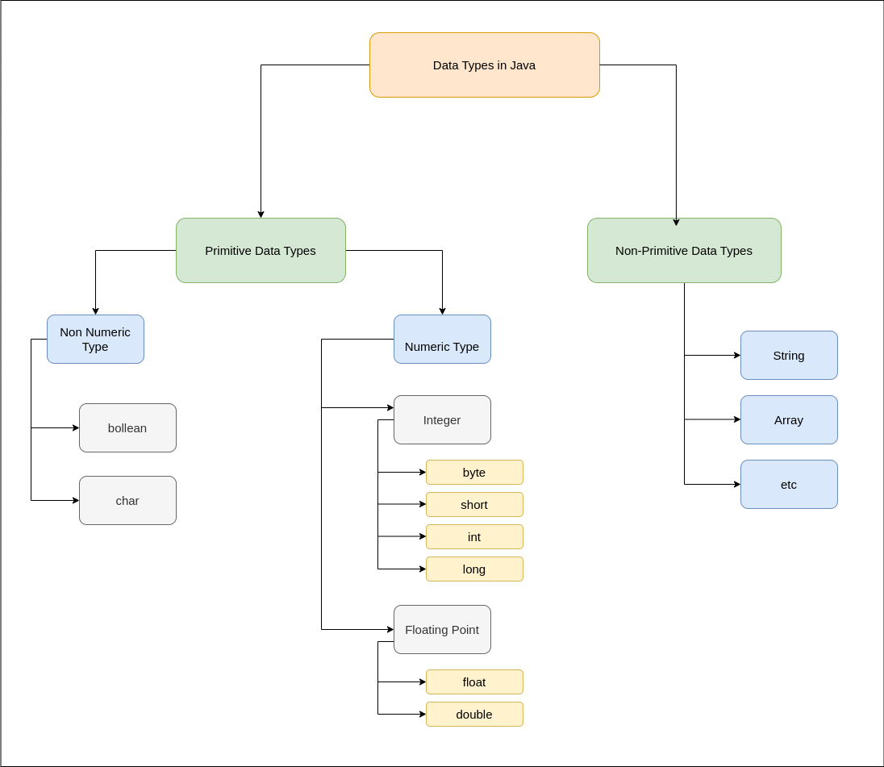
Java

Slide 16
Java
Primitive Data Types in Java
Primitive data are only single values and have no special capabilities. There are 8 primitive data types.
Data Type | Default Value | Default size
boolean | false | 1 bit
char | '\u0000' | 2 byte
byte | 0 | 1 byte
short | 0 | 2 byte
int | 0 | 4 byte
long | 0L | 8 byte
float | 0.0f | 4 byte
double | 0.0d | 8 byte

Slide 17
Java
1. Boolean Data Type
Boolean data type represents only one bit of information either true or false which is intended to represent the two truth values of logic and Boolean algebra, but the size of the boolean data type is virtual machine-dependent. Values of type boolean are not converted implicitly or explicitly (with casts) to any other type. But the programmer can easily write conversion code.
2. Byte Data Type
The byte data type is an 8-bit signed two’s complement integer. The byte data type is useful for saving memory in large arrays.
3. Short Data Type
The short data type is a 16-bit signed two’s complement integer. Similar to byte, use a short to save memory in large arrays, in situations where the memory savings actually matters.
4. Integer Data Type
It is a 32-bit signed two’s complement integer.

Slide 18
Java
5. Long Data Type
The range of a long is quite large. The long data type is a 64-bit two’s complement integer and is useful for those occasions where an int type is not large enough to hold the desired value. The size of the Long Datatype is 8 bytes (64 bits).
7. Double Data Type
The double data type is a double-precision 64-bit IEEE 754 floating-point. For decimal values, this data type is generally the default choice. The size of the double data type is 8 bytes or 64 bits.
8. Char Data Type
The char data type is a single 16-bit Unicode character with the size of 2 bytes (16 bits).
Why is the Size of char 2 bytes in Java?
So, other languages like C/C++ use only ASCII characters, and to represent all ASCII characters 8 bits is enough. But Java uses the Unicode system not the ASCII code System and to represent the Unicode system 8 bits is not enough to represent all characters so Java uses 2 bytes for characters. Unicode defines a fully international character set that can represent most of the world’s written languages. It is a unification of dozens of character sets, such as Latin, Greek, Cyrillic, Katakana, Arabic, and many more.

Slide 19
Java
Non-Primitive Data Type or Reference Data Types
The Reference Data Types will contain a memory address of variable values because the reference types won’t store the variable value directly in memory. They are strings, objects, arrays, etc.
1. Strings
Strings are defined as an array of characters. The difference between a character array and a string in Java is, that the string is designed to hold a sequence of characters in a single variable whereas, a character array is a collection of separate char-type entities. Unlike C/C++, Java strings are not terminated with a null character.
Syntax: Declaring a string
<String_Type> <string_variable> = “<sequence_of_string>”;

Slide 20
Java
Literals in Java
Any constant value which can be assigned to the variable is called literal/constant.
In simple words, Literals in Java is a synthetic representation of boolean, numeric, character, or string data. It is a medium of expressing particular values in the program, such as an integer variable named ‘’/count is assigned an integer value in the following statement.
// Here 100 is a constant/literal.
int x = 100;
Integral literals
For Integral data types (byte, short, int, long)
Floating-Point literal
Floating-point data types, we can specify literals in only decimal form, and we cant specify in octal and Hexadecimal forms.
double d = 123.456;
Char literals : For char data types
char ch = 'a';

Slide 21
Java
String literals
Any sequence of characters within double quotes is treated as String literals.
String s = "Hello";
Boolean literals
Only two values are allowed for Boolean literals, i.e., true and false.
boolean b = true;

Slide 22
Java
String literals
Any sequence of characters within double quotes is treated as String literals.
String s = "Hello";
Boolean literals
Only two values are allowed for Boolean literals, i.e., true and false.
boolean b = true;

Slide 23

Thank you

